Slide 1
CSET301 – AI-ML
Lecture 11 : Ensemble Learning

Slide 2
Outline
Ensemble Learning
Bootstrap Aggregating (Bagging)
Boosting
Random Forest

Slide 3
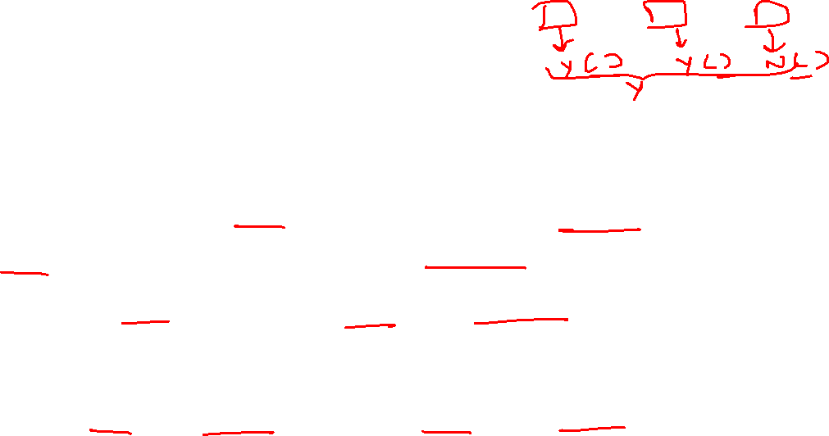
Ensemble Learning
Ensemble learning methods are meta-algorithms that combine several machine learning methods into a single predictive model to increase performance.
An ensemble is a composite model, combines a series of low performing classifiers with the aim of creating a single improved classifier.
Each individual classifier gives a prediction and final prediction is taken by majority voting.
Ensembles offer more accuracy than individual or base classifier.

Slide 4
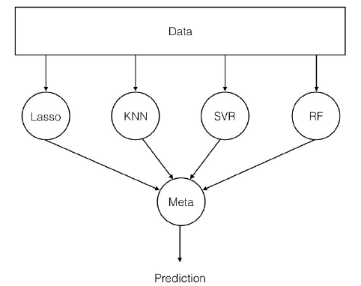
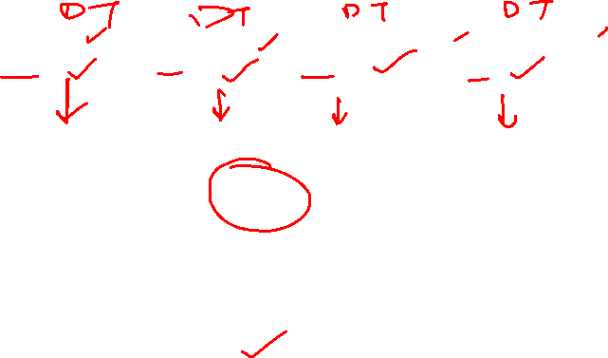
Basic Ensemble Structure

Slide 5
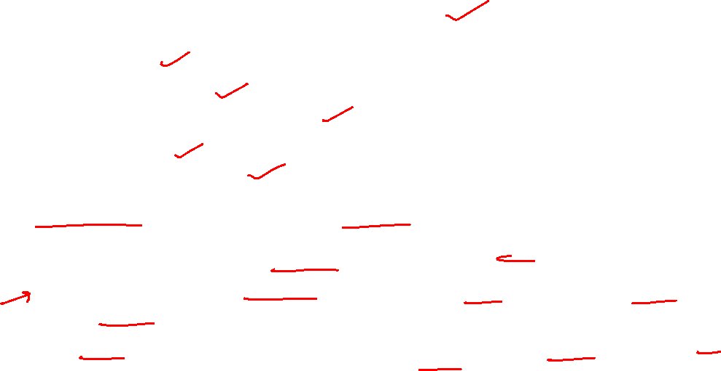
Ensemble Learning: Summary Points
Use multiple learning algorithms (classifiers)
Different learners use different
  – Algorithms
  – Hyperparameters
  – Representations (Modalities)
  – Training sets
Combine the decisions
Can be more accurate than the individual classifiers
Two main reasons to use an ensemble over a single model:
Performance: An ensemble can make better predictions and achieve better performance than any single contributing model.
Robustness: An ensemble reduces the spread or dispersion of the predictions and model performance.

Slide 6
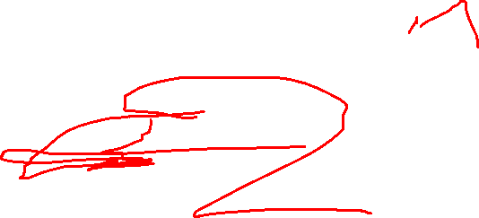
Ensemble Learning methods in DT
Bagging (Bootstrap Aggregating)
Boosting

Slide 7
Bagging

Slide 8
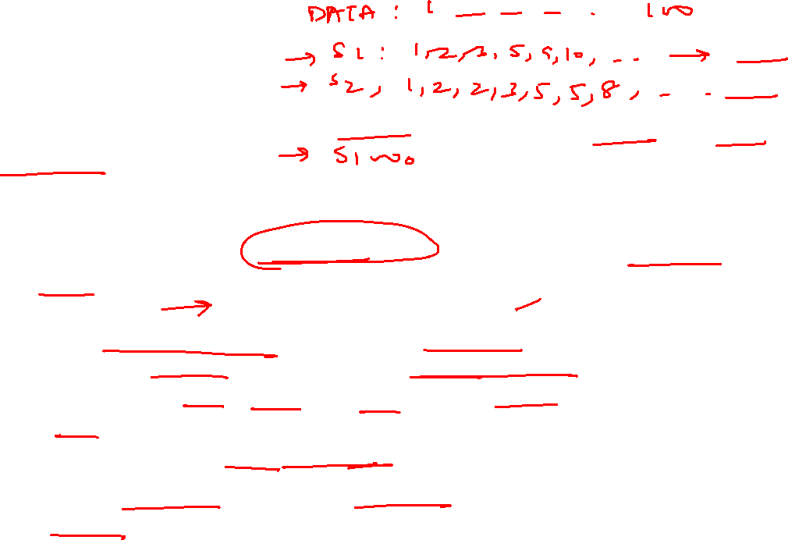
Bootstrap
The bootstrap is a powerful statistical method for estimating a quantity from a data sample.
Example:
Let’s say we have a sample of 100 values (x) and we want to estimate the mean of the sample.
mean(x) = sum(x) * 1/100
We know that our sample is small and that our mean has error in it. We can improve the estimate of our mean using the bootstrap procedure:
  – Create many (e.g. 1000) random sub-samples of our dataset with replacement.
  – Calculate the mean of each sub-sample.
  – Calculate the average of all of our collected means and use that as our estimated mean for the data.

Slide 9
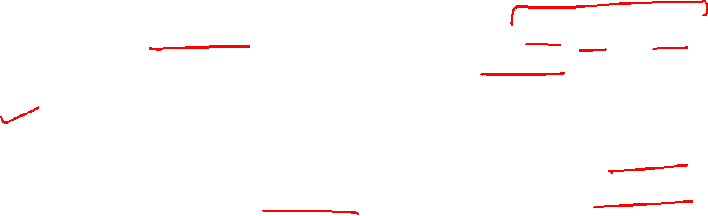
Bootstrap
Let’s say we used 3 resamples and got the mean values 2.3, 4.5 and 3.3.
Taking the average of these, we could take the estimated mean of the data to be 3.367.
This process can be used to estimate other quantities like the standard deviation and even quantities used in machine learning algorithms, like learned coefficients.

Slide 10
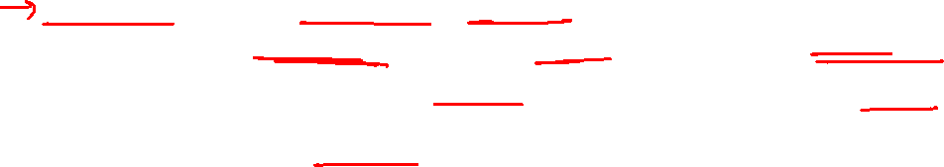
Bagging
Bagging stands for bootstrap aggregation.
It combines multiple learners in a way to reduce the variance of estimates.
For example, you can train n different trees on different random subsets of the data and perform voting for final prediction.

Slide 11
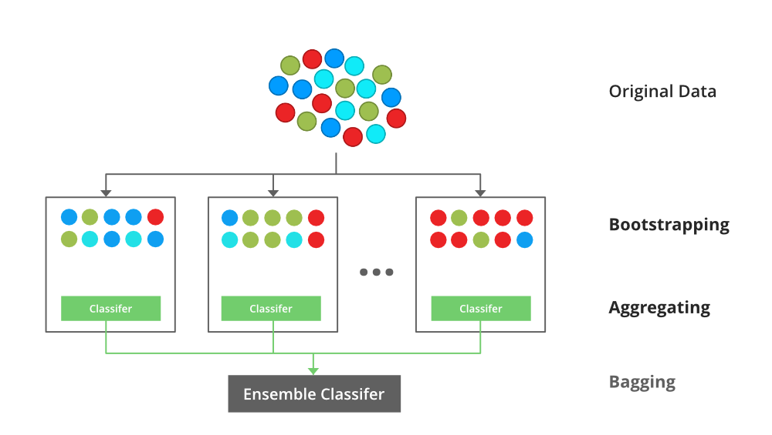
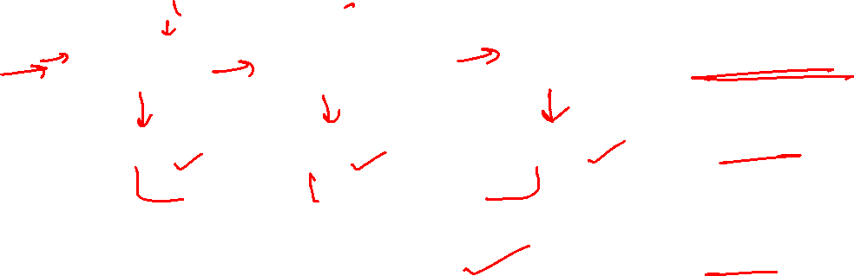
Bagging

Slide 12
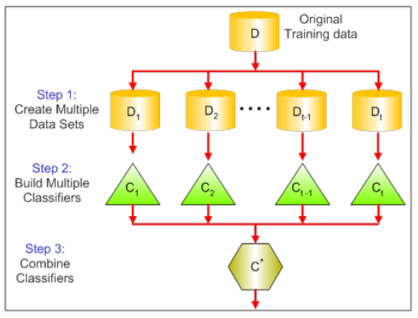
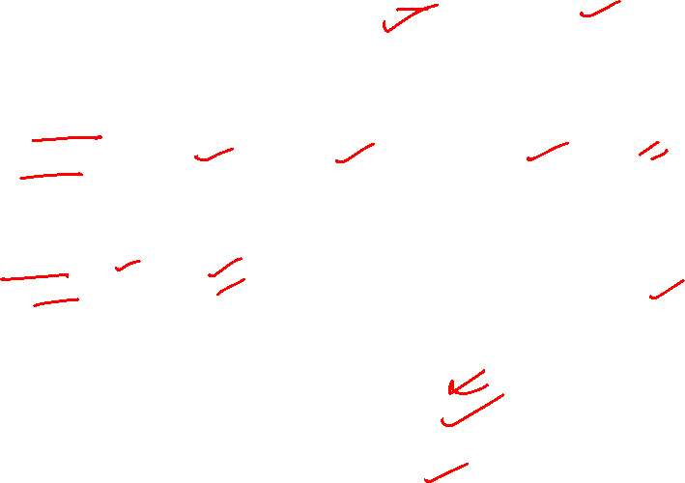
Bagging

Slide 13
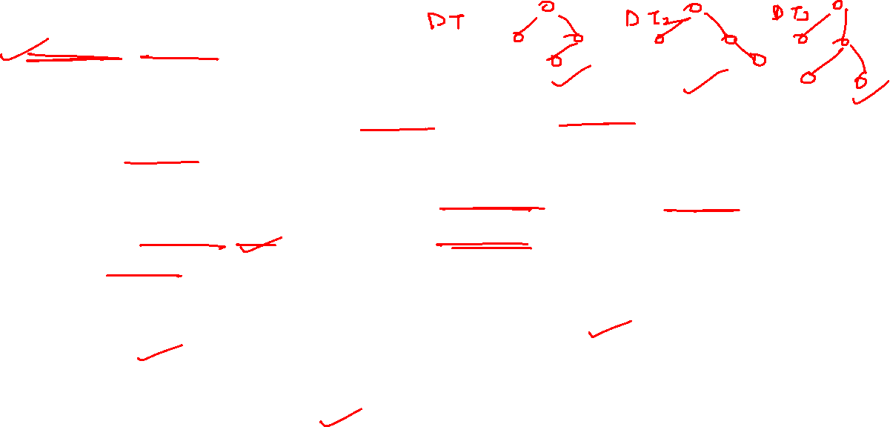
Random Forest
Random forest is a type of supervised machine learning algorithm based on ensemble learning.
The random forest algorithm combines multiple algorithm of the same type i.e. multiple decision trees, resulting in a forest of trees, hence the name "Random Forest".
The random forest algorithm can be used for both regression and classification tasks.
Uses the concept of Bagging.

Slide 14
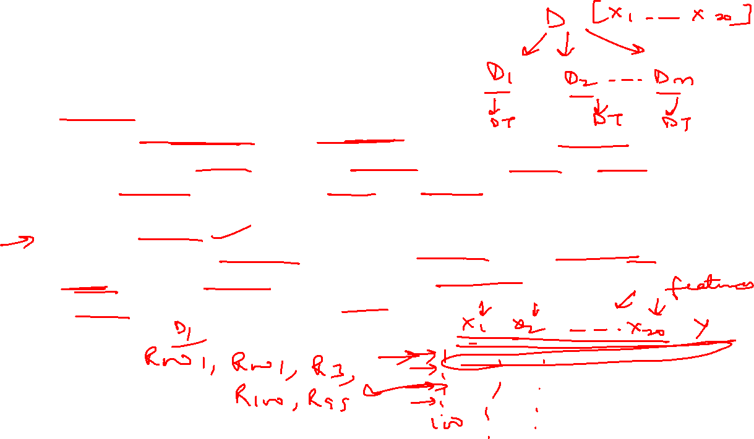
How Random Forest works
Bagging
Create multiple subsets of original training data (Done through Bootstrapping. Here, a single data point can appear multiple times in one subset or not at all).
Each bootstrap sample is used to train individual decision tree.
Feature randomness
When building individual decision tree, random forest randomly selects a subset of features. This "feature bagging" further diversifies the trees and reduces the correlation between them, making the ensemble more robust.

Slide 15
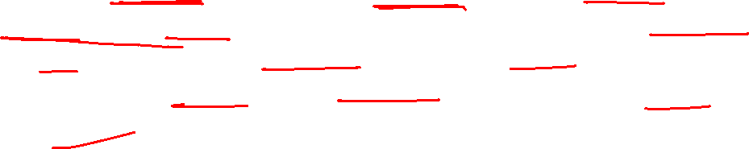
How Random Forest works
Building Individual Decision Trees:
For each bootstrap sample and its selected features, a decision tree is grown to its full depth without pruning. This is a key difference from standard decision tree algorithms, where pruning is often used to prevent overfitting. The randomness introduced in the sampling and feature selection steps helps mitigate overfitting in the Random Forest as a whole.

Slide 16
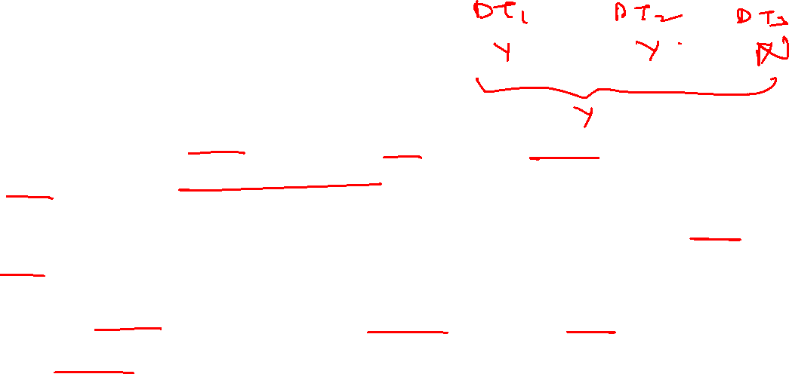
How Random Forest works
Prediction Aggregation:
Once all the individual decision trees are built, the Random Forest makes predictions by aggregating the outputs of these trees.
  – For Classification Tasks: The final prediction is determined by a "majority vote." The class predicted by the most individual trees is chosen as the final output.
  – For Regression Tasks: The final prediction is the average of the predictions made by all the individual trees.

Slide 17
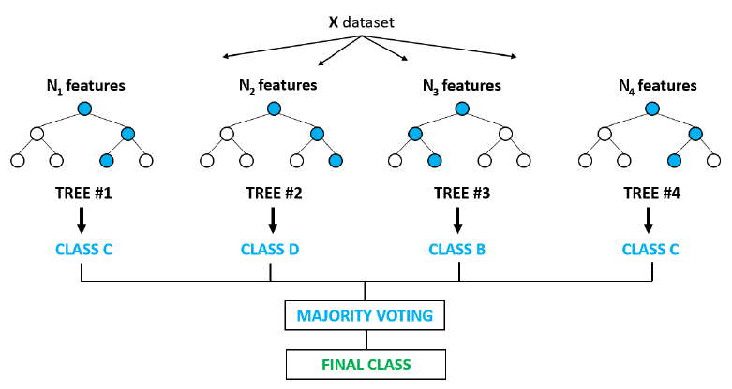
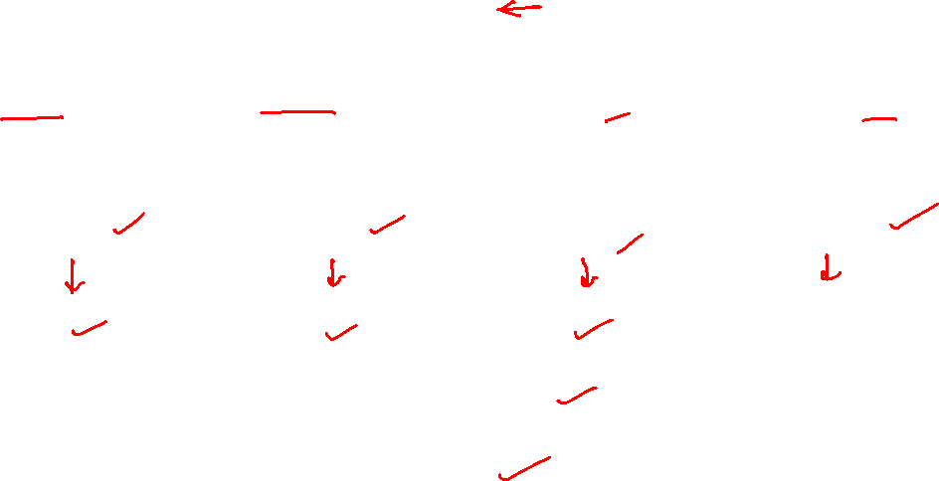
Majority voting

Slide 18
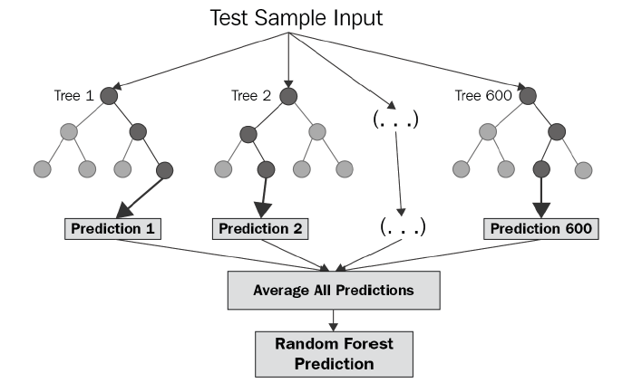

Regressor output

Slide 19
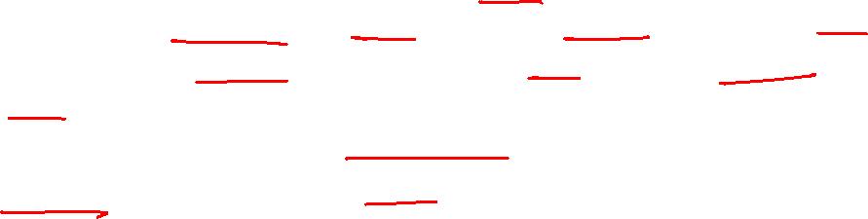
Random Forest Summary
The Random Forest algorithm is an ensemble ML method that operates by constructing a multitude of decision trees during training and outputting the class that is the mode of the classes (for classification) or mean prediction (for regression) of the individual trees.
This approach leverages the "wisdom of crowds" principle to improve prediction accuracy and reduce overfitting compared to a single decision tree.

Slide 20
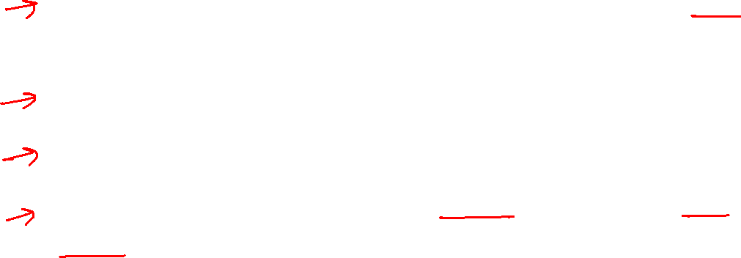
Random Forest Summary
Why it works well:
Reduces Overfitting: By combining predictions from multiple diverse trees, Random Forest significantly reduces the risk of overfitting, which is a common problem with individual decision trees.
Improved Accuracy: The ensemble approach typically leads to more accurate and stable predictions than a single decision tree.
Handles High-Dimensional Data: It can effectively handle datasets with a large number of features.
Robust to Missing Values: It can maintain accuracy even when a portion of the data is missing.

Slide 21
Boosting

Slide 22
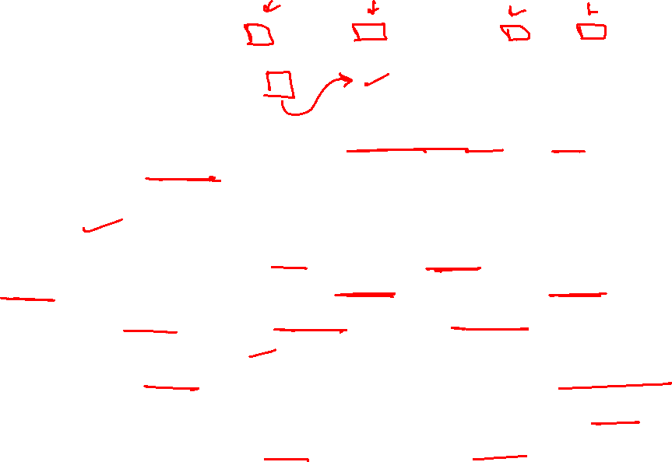
Boosting
Boosting algorithms are a set of the low accurate/weak classifier to create a highly accurate/strong classifier.
Weak Classifiers are models that perform only slightly better than random guessing.
This is done by building a model from the training data, then creating a second model that attempts to correct the errors from the first model.
Models are added until the training set is predicted perfectly or a maximum number of models are added.
Highly accurate classifier (or strong classifier) offer error rate close to 0.
Boosting algorithm can track the model who failed the accurate prediction.
Boosting algorithms are less affected by the overfitting problem.

Slide 23
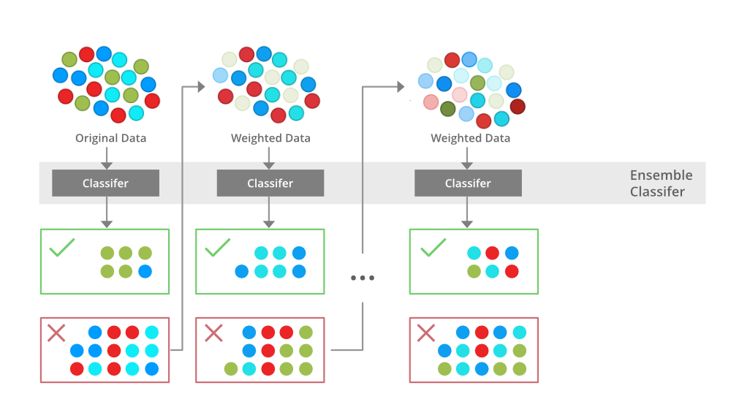
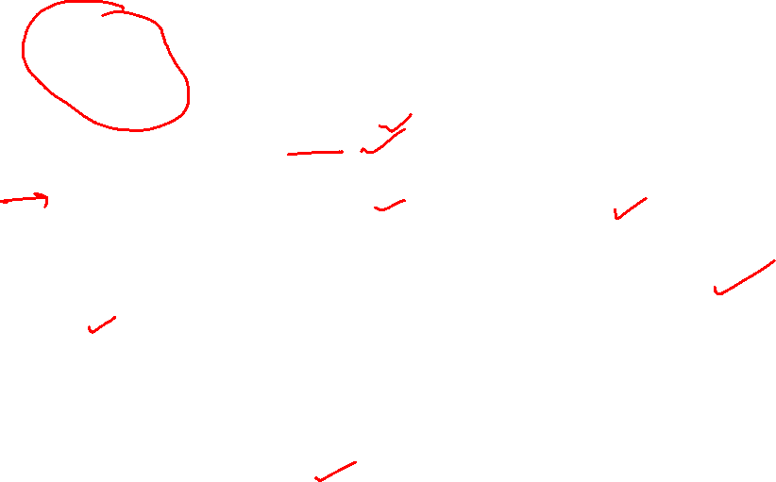
Boosting

Slide 24
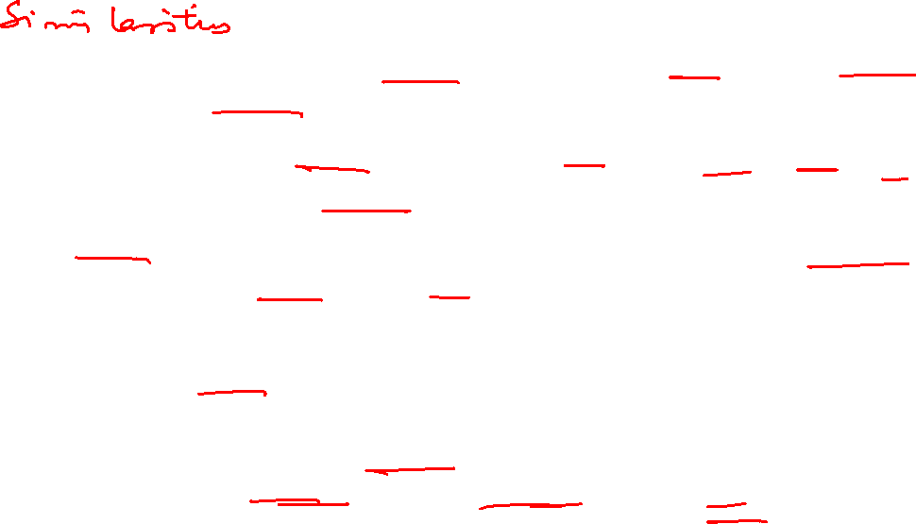
Bagging and Boosting
Both techniques combine the predictions of multiple individual models (base/weak learners) to create a more robust and accurate final model.
Both enhances the overall performance by reducing errors (variance in Bagging, bias in Boosting) and improving generalization to unseen data.
Versatility: Bagging and Boosting can be applied to a wide range of machine learning tasks, including both classification and regression problems.
In both approaches, the final prediction is derived by combining the predictions of the individual base learners, typically through averaging (for regression) or majority voting (for classification).
Both aim to reduce different types of errors present in single models. Bagging primarily focuses on reducing variance, while Boosting aims to reduce bias. The ultimate outcome is a more stable and accurate model.

Slide 25
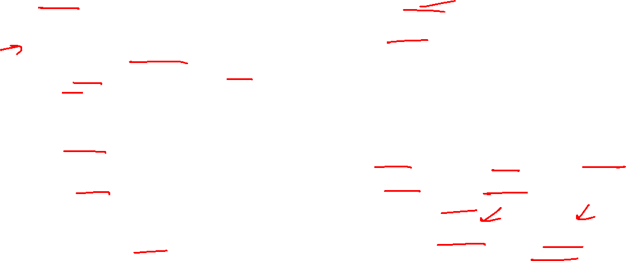
Bagging and Boosting
Differences:
Parallel training
Bootstrap sampling: Each base model is trained on a different subset of the original training data, created through bootstrap sampling (random sampling with replacement).
Variance Reduction: The primary goal of bagging is to reduce variance and prevent overfitting by averaging or voting the predictions of multiple diverse models.
Example: Random Forest
Sequential training
Weighted Data: Boosting algorithms assign higher weights to misclassified data points, ensuring that subsequent models pay more attention to these difficult instances.
Bias Reduction: The main objective of boosting is to reduce bias and improve overall accuracy by iteratively learning from and correcting errors.
Examples: AdaBoost, Gradient Boosting Machines (GBM), and XGBoost are well-known boosting algorithms.

Slide 26
Thank You

